Slide 1
Introduction
An ecosystem consists of all the organisms living in a community as well as all the abiotic factors with which they interact.
The dynamics of an ecosystem involve two processes: energy flow and chemical cycling.
Ecosystem ecologists view ecosystems as energy machines and matter processors.
We can follow the transformation of energy by grouping the species in a community into trophic levels of feeding relationships.

Slide 2
The laws of physics and chemistry apply to ecosystems
The law of conservation of energy applies to ecosystems.
  We can potentially trace all the energy from its solar input to its release as heat by organisms.
The second law of thermodynamics allows us to measure the efficiency of the energy conversions.

Slide 3
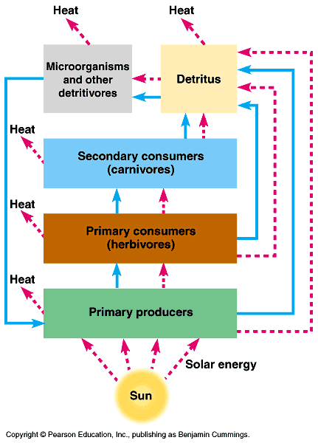

Slide 4
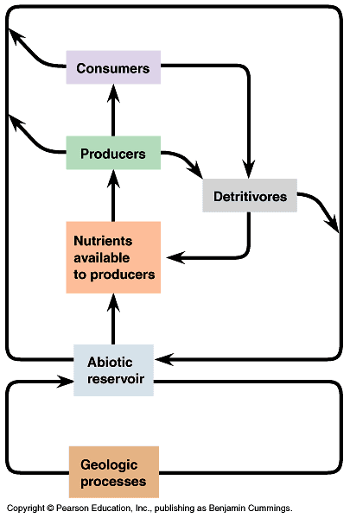

Slide 5
An ecosystem’s energy budget depends on primary production
Most primary producers use light energy to synthesize organic molecules, which can be broken down to produce ATP; there is an energy budget in an ecosystem.

Slide 6
The Global Energy Budget
  Every day, Earth is bombarded by large amounts of solar radiation.
    Much of this radiation lands on the water and land that either reflect or absorb it.
    Of the visible light that reaches photosynthetic organisms, about only 1% is converted to chemical energy.
      Although this is a small amount, primary producers are capable of producing about 170 billion tons of organic material per year.

Slide 7
Gross and Net Primary Production.
  Total primary production is known as gross primary production (GPP).
    This is the amount of light energy that is converted into chemical energy.
  The net primary production (NPP) is equal to gross primary production minus the energy used by the primary producers for respiration (R):
    NPP = GPP – R

Slide 8
  Primary production can be expressed in terms of energy per unit area per unit time, or as biomass of vegetation added to the ecosystem per unit area per unit time.
    This should not be confused with the total biomass of photosynthetic autotrophs present in a given time, called the standing crop.

Slide 9
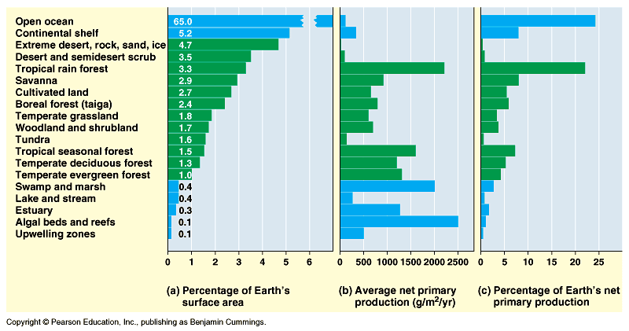
  Different ecosystems differ greatly in their production as well as in their contribution to the total production of the Earth.

Slide 10
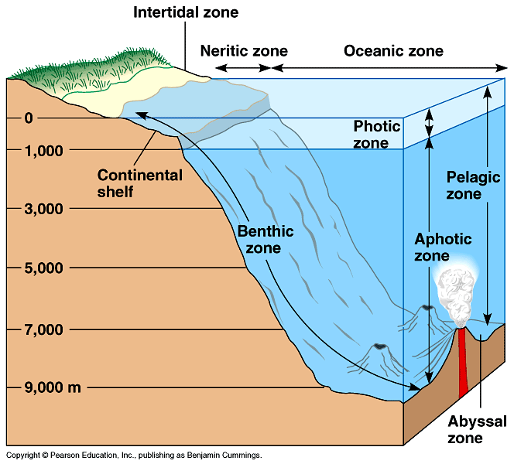
Production in Marine ecosystems.
  Light is the first
  variable to control
  primary production
  in oceans, since
  solar radiation
  can only penetrate
  to a certain depth
  (photic zone).

Slide 11
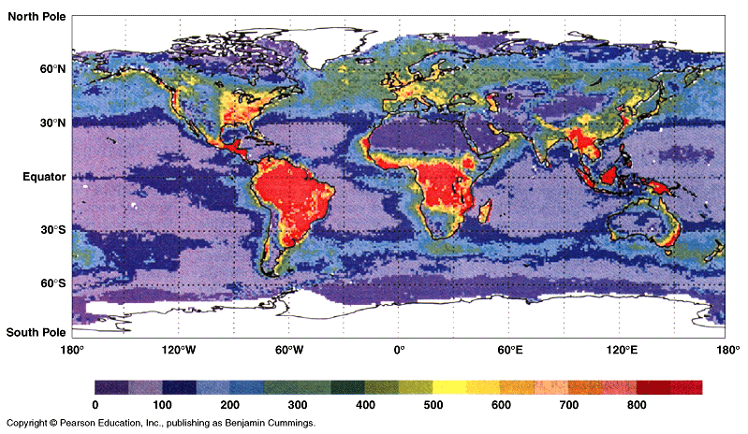
  We would expect production to increase along a gradient from the poles to the equator; but that is not the case.
    There are parts of the ocean in the tropics and subtropics that exhibit low primary production.

Slide 12
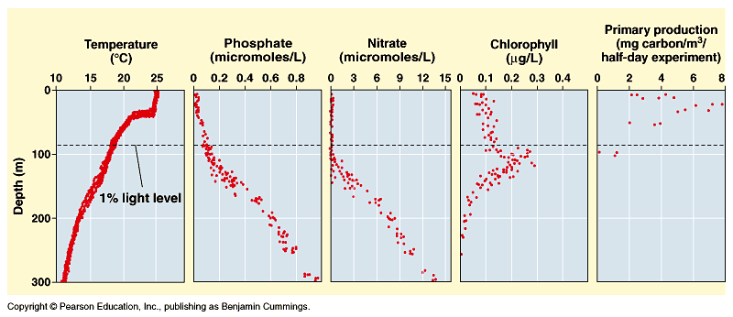
      In the open ocean, nitrogen and phosphorous levels are very low in the photic zone, but high in deeper water where light does not penetrate.

Slide 13
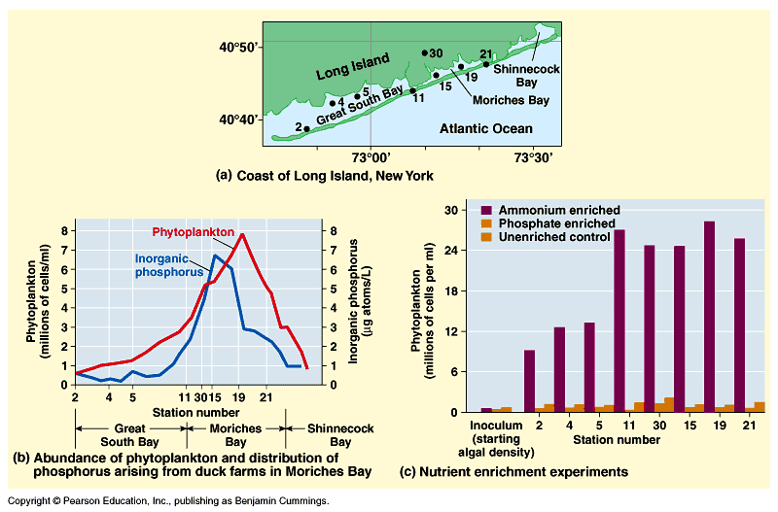
    Nitrogen is the one nutrient that limits phytoplankton growth in many parts of the ocean.

Slide 14
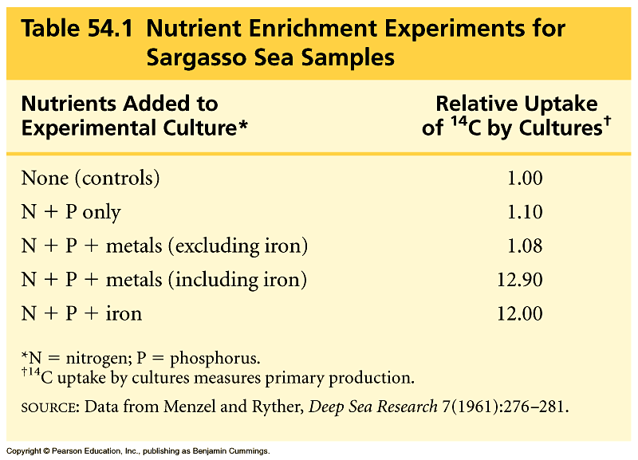
      Nutrient enrichment experiments showed that iron availability limited primary production.

Slide 15
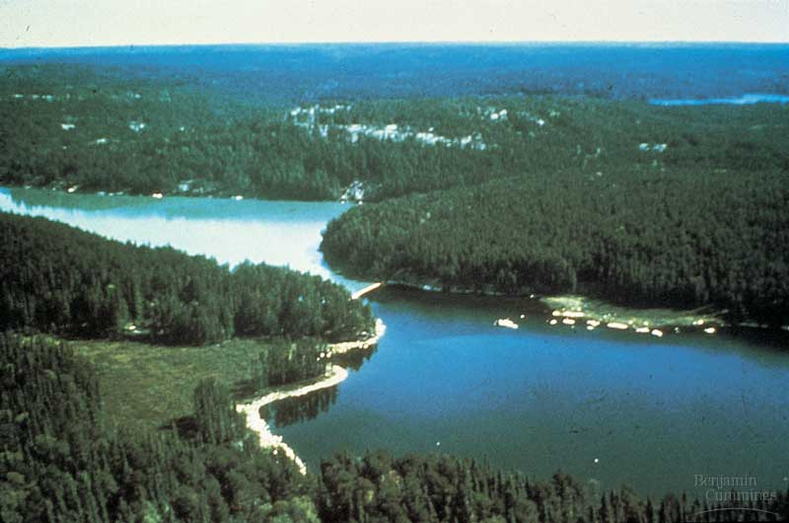
Production in Freshwater Ecosystems.
  Solar radiation and temperature are closely linked to primary production in freshwater lakes.
  During the 1970s, sewage and fertilizer pollution added nutrients (especially P) to lakes, which shifted many lakes from having phytoplankton communities to those dominated by diatoms and green algae.

Slide 16
In terrestrial ecosystems, temperature, moisture, and nutrients limit primary production
Obviously, water availability varies among terrestrial ecosystems more than aquatic ones.
  On a large geographic scale, temperature and moisture are the key factors controlling primary production in ecosystems.

Slide 17
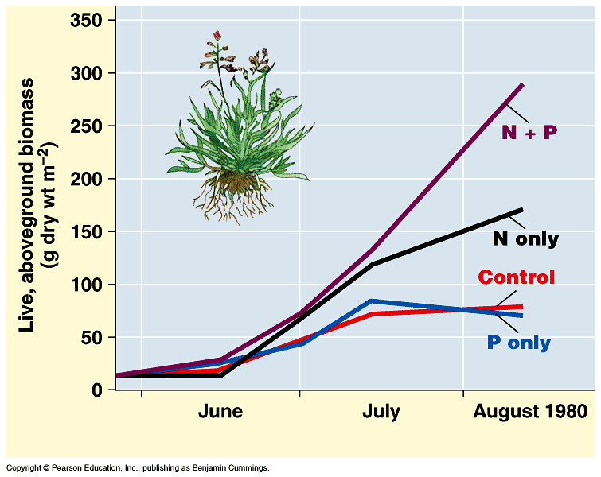
  On a more local scale, mineral nutrients in the soil can play key roles in limiting primary production.
    Scientific studies relating nutrients to production have practical applications in agriculture.

Slide 18
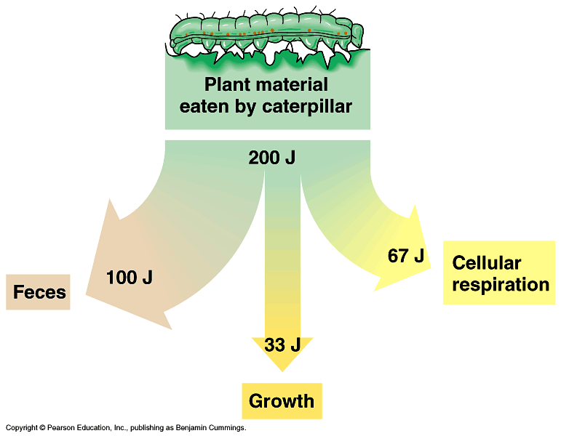
The efficiency of energy transfer between trophic levels is usually less than 20%
Production Efficiency.
  One way to understand
  secondary production is
  to examine the
  process in
  individual
  organisms.

Slide 19
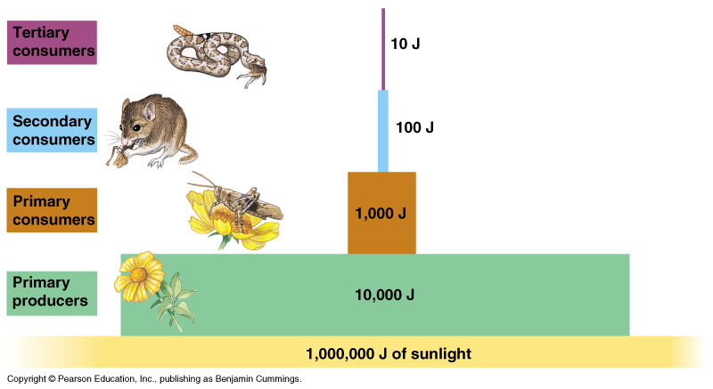

Slide 20
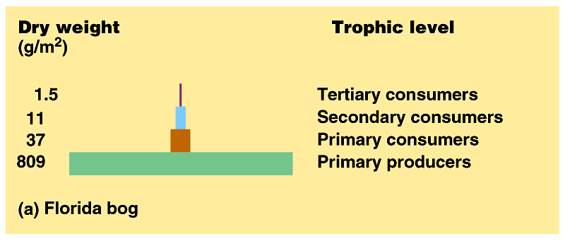
    Pyramids of biomass represent the ecological consequence of low trophic efficiencies.
      Most biomass pyramids narrow sharply from primary producers to top-level carnivores because energy transfers are inefficient.

Slide 21
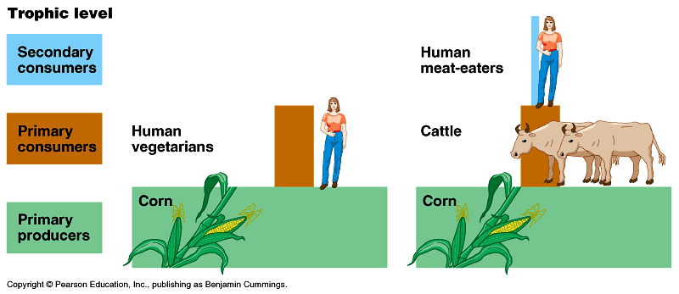
  The dynamics of energy through ecosystems have important implications for the human population.

Slide 22
Herbivores consume a small percentage of vegetation: the green world hypothesis
According to the green world hypotheses, herbivores consume relatively little plant biomass because they are held in check by a variety of factors including:
    Plants have defenses against herbivores
    Nutrients, not energy supply, usually limit herbivores
    Abiotic factors limit herbivores
    Intraspecific competition can limit herbivore numbers
    Interspecific interactions check herbivore densities

Slide 23
Biological and geologic processes move nutrients between organic and inorganic compartments
A general model of chemical cycling.
  There are four main reservoirs of elements and processes that transfer elements between reservoirs.
    Reservoirs are defined by two characteristics, whether it contains organic or inorganic materials, and whether or not the materials are directly usable by organisms.

Slide 24
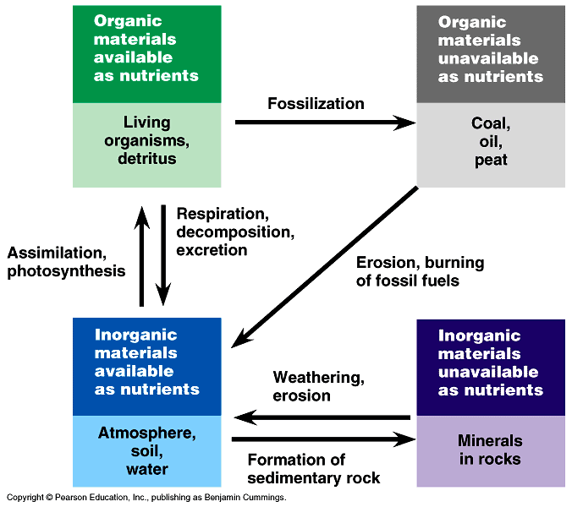

Slide 25
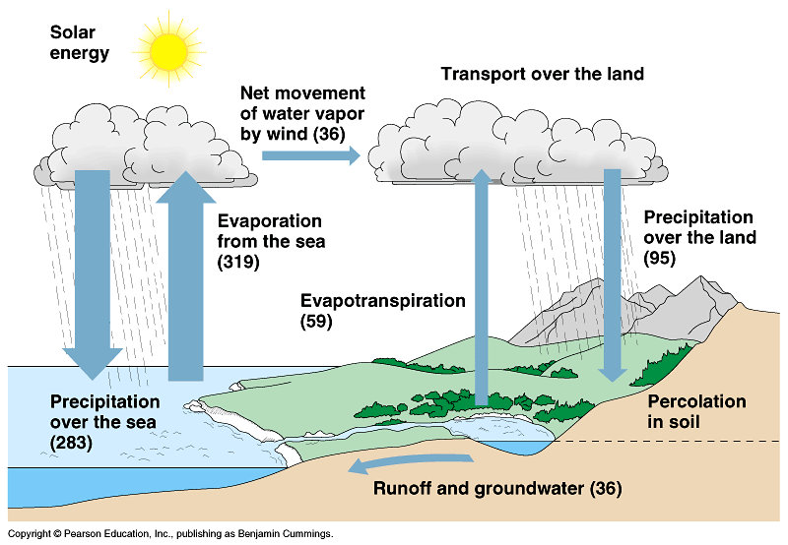
  The water cycle is more of a physical process than a chemical one.

Slide 26
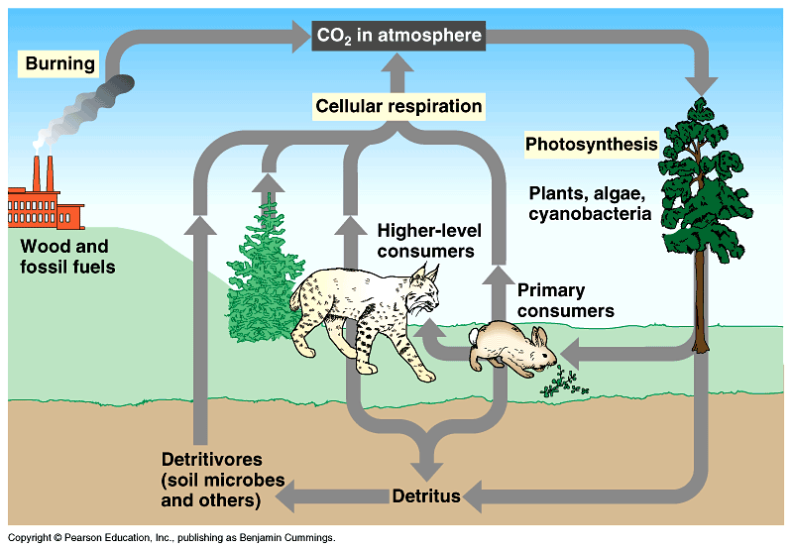
    The carbon cycle fits the generalized scheme of biogeochemical cycles better than water.

Slide 27
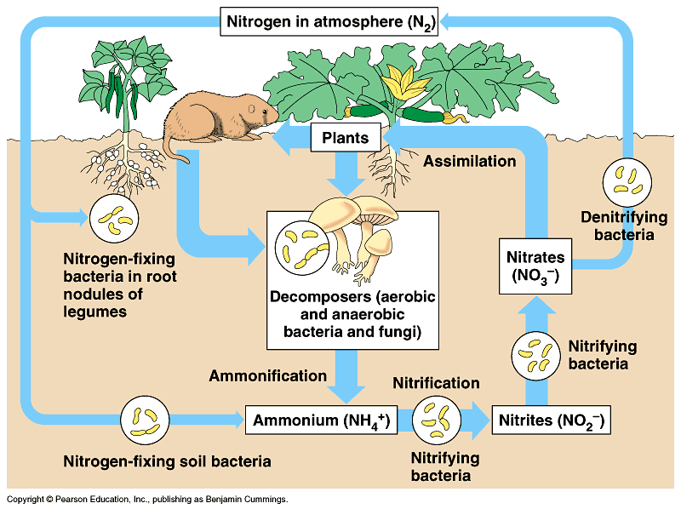

Slide 28
Decomposition rates largely determine the rates of nutrient cycling
The rates at which nutrients cycle in ecosystems are extremely variable as a result of variable rates of decomposition.
  Decomposition can take up to 50 years in the tundra, while in the tropical forest, it can occur much faster.
  Contents of nutrients in the soil of different ecosystems vary also, depending on the rate of absorption by the plants.

Slide 29
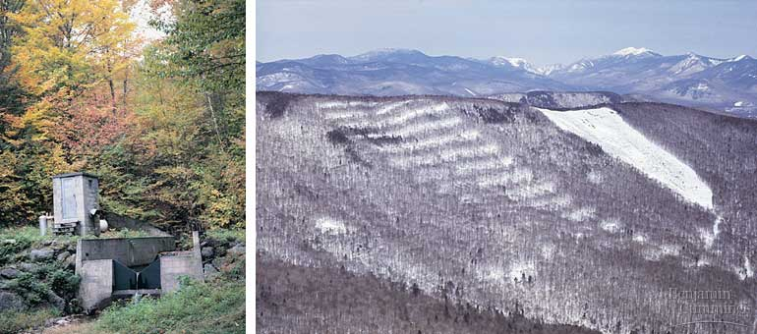
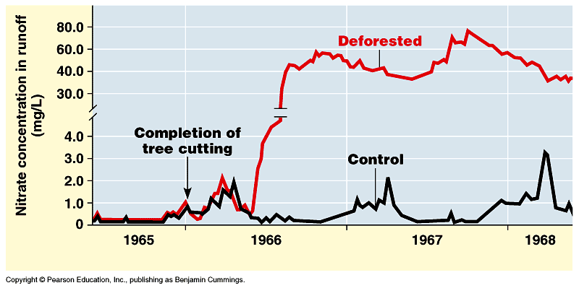
Nutrient cycling is strongly regulated by vegetation.

Slide 30
The human population is disrupting chemical cycles throughout the biosphere
Human activity intrudes in nutrient cycles by removing nutrients from one part of the biosphere and then adding them to another.
Agricultural effects of nutrient cycling.

Slide 31
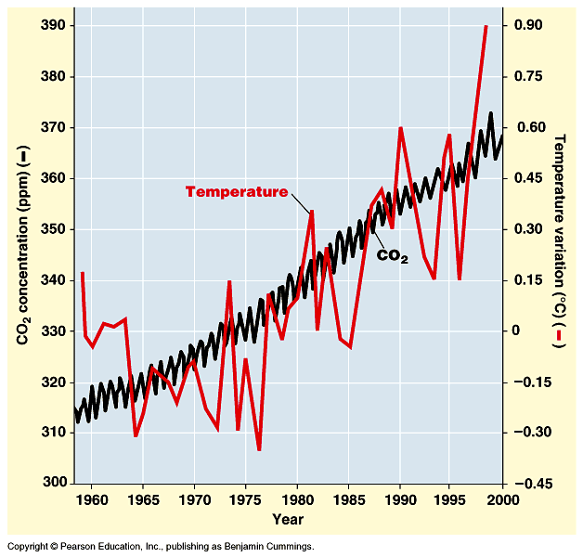
Measurements in 1958 read 316 ppm and increased to 370 ppm today

Slide 32
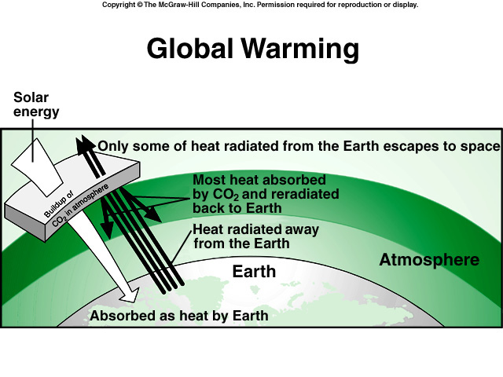

Slide 33
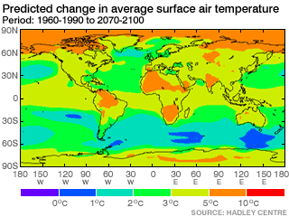

Slide 34
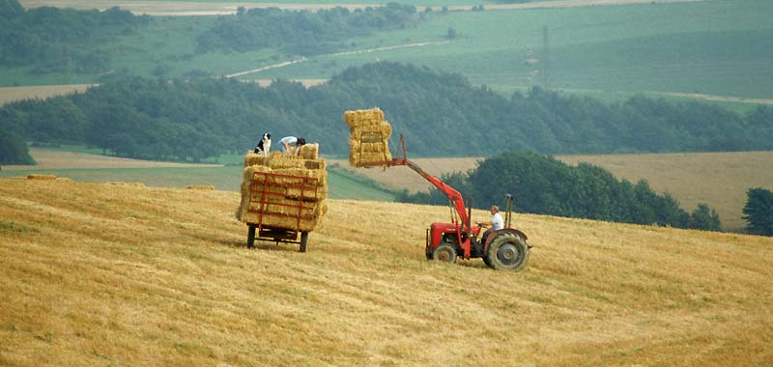
  In agricultural ecosystems, a large amount of nutrients are removed from the area in the crop biomass.
    After awhile, the natural store of nutrients can become exhausted.

Slide 35
  Recent studies indicate that human activities have approximately doubled the worldwide supply of fixed nitrogen, due to the use of fertilizers, cultivation of legumes, and burning.
    This may increase the amount of nitrogen oxides in the atmosphere and contribute to atmospheric warming, depletion of ozone and possibly acid rain.

Slide 36
Critical load and nutrient cycles.
  In some situations, the addition of nitrogen to ecosystems by human activity can be beneficial, but in others it can cause problems.
  The key issue is the critical load, the amount of added nitrogen that can be absorbed by plants without damaging the ecosystem.

Slide 37
Accelerated eutrophication of lakes.
  Human intrusion has disrupted freshwater ecosystems by what is called cultural eutrophication.
    Sewage and factory wastes, runoff of animal wastes from pastures and stockyards have overloaded many freshwater streams and lakes with nitrogen.
    This can eliminate fish species because it is difficult for them to live in these new conditions.

Slide 38
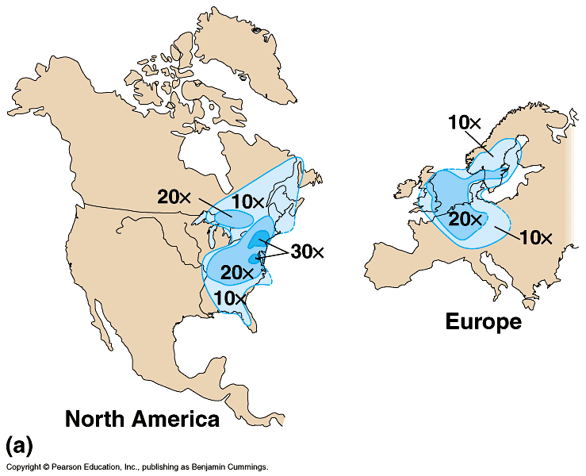
Combustion of fossil fuels is the main cause of acid precipitation
The burning of
fossil fuels
releases sulfur
oxides and nitrogen that
react with water
in the atmosphere
to produce sulfuric and nitric acids.

Slide 39
Toxins can become concentrated in successive trophic levels of food webs
Humans produce many toxic chemicals that are dumped into ecosystems.
  These substances are ingested and metabolized by the organisms in the ecosystems and can accumulate in the fatty tissues of animals.
  These toxins become more concentrated in successive trophic levels of a food web, a process called biological magnification.

Slide 40
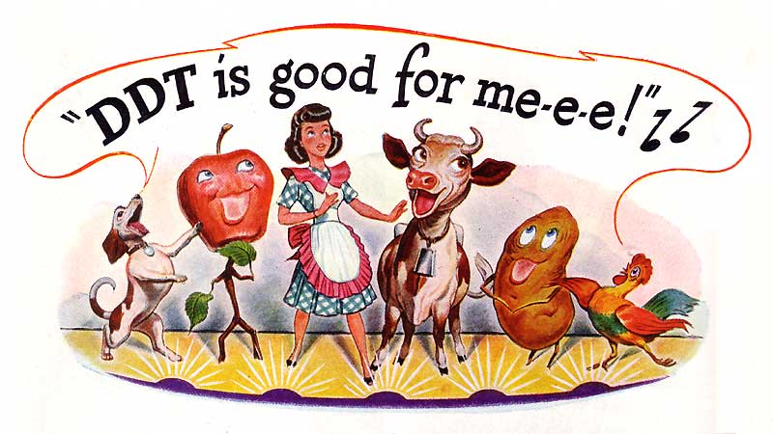
The pesticide DDT, before it was banned, showed this affect.

Slide 41
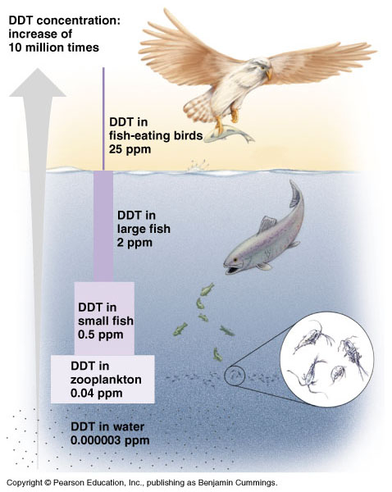

Slide 42
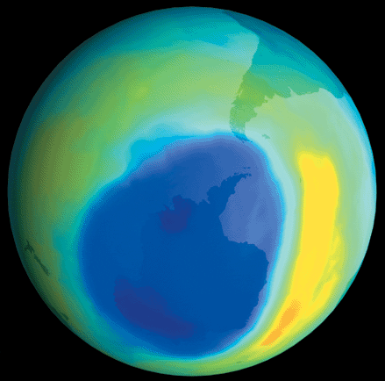
Human activities are depleting the atmospheric ozone
Life on earth is protected from the damaging affects of ultraviolet radiation (UV) by a layer of O₃,
or ozone.
Studies suggest that
the ozone layer has
been gradually
“thinning” since 1975.

Slide 43
The destruction of ozone probably results from the accumulation of chlorofluorocarbons, chemicals used in refrigeration and aerosol cans, and in certain manufacturing processes.
  The result of a reduction in the ozone layer may be increased levels of UV radiation that reach the surface of the Earth.
    This radiation has been linked to skin cancer and cataracts.
The impact of human activity on the ozone layer is one more example of how much we are able to disrupt ecosystems and the entire biosphere.

